Slide 1
Remembering Indian Soldiers in WWI
Heritage Lottery Fund
Golden Tours Foundation

Slide 2
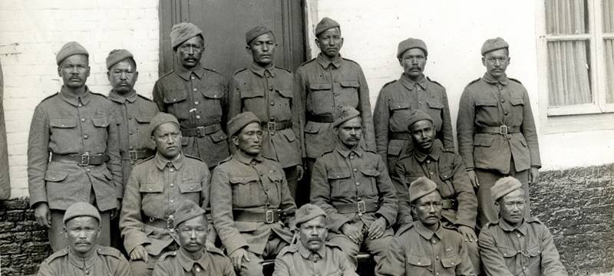

Slide 3
The Project
Remembering Indian Soldiers of WW1 is a Project of the Golden Tours Foundation and is funded by the Heritage Lottery Fund.
The Golden Tours Foundation is a charitable organization established in 2013 to offer life-changing opportunities for people to help fulfill their aspirational goals. It has a broad spectrum of charitable aims nurturing on the philosophy of personal, social and economic growth.
Heritage Lottery Fund is the largest dedicated founder of heritage in the UK and is the leading advocate for the value of heritage.

Slide 4
WHY : The Need
The Indian contribution to the WWI was considerable but the narrative is mostly missing hence the need to highlight the relevancy of the Indian contribution, as an important legacy for Britain.
The role of the Indian Soldiers particularly of lesser known communities, regions and all faiths like Hindus, Zoroastrians, Jains, Buddhists needs to be highlighted.
Engaging and broadening the understanding of these communities particularly and the wider public generally, by way of heritage sharing.

Slide 5
WHY : The Need
A sense of shared history brings communities together and in today's multi faith Britain, it facilitates integration within and with the wider society.
By giving room to a multiplicity of voices and forming a circle of engagement, the role of lesser known communities both faith and ethnic will enable and empower them.
RELEVANCE through REMEMBRANCE.

Slide 6
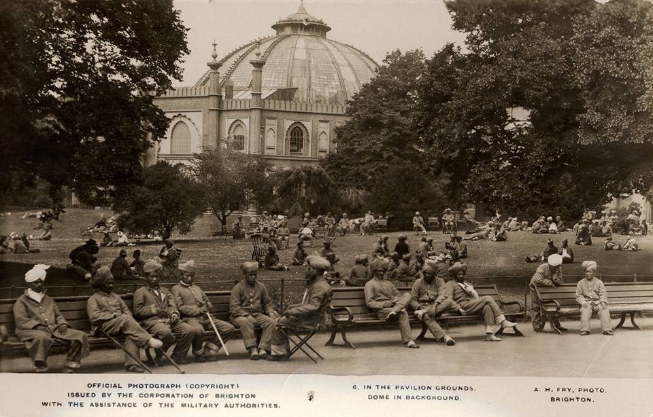

Slide 7
Fast Facts
Indian Soldiers Combatants + Non-Combatants : 1.5 million
Indian Deaths : 74,187
Victoria Crosses : 12
Animals from India : 170,000
First Indian casualties of WW1 happened on Indian soil, when Madras got bombed on the night of 22nd September, 1914 by the German cruise ship SMS Emden.

Slide 8
Active Indian Service : Theatres of War
Western Front (1914-18)
Italian Campaign (1917-18)
Macedonian Front (1915-18)
Gallipoli Campaign (1915-16)
North Africa Campaign (1915-16)
Sinai & Palestine Campaign (1915-18)
China Operations (1914)
Persian Campaign( 1914-18)
Mesopotamian Campaign (1914-20)
South Arabian Campaign (1914-19)
North West Frontier Province (1914-18)
Russian Operations (1918-19)
East African Campaign (1914-1918)

Slide 9
Kishan Devi Postcard to Sepoy Sewa Singh Serving with Empire Troops in Egypt (1916)
"…Dear Father please take leave and come to meet us. Please do come. We repeat again and again. Reply to our letter soon…"

Slide 10
WHAT : Multi-pronged Approach
Raising awareness.
Partnering with community organizations.
Focusing on the Inter Faith aspect of the War.
Engaging all stakeholders.
Drawing linkages between academicians/practitioners and the community.

Slide 11
HOW: Circle of Engagement
3 one-day events across the UK, 2 in London and 1 in Leicester.
Consultation with Sai School in Harrow.
Recording Oral History.
And e-book on Fallen Indian Soldiers.
Webinars linking young people in India and the UK to discuss WWI and British identity.
A website which will signpost, contain archive material and to which the public can contribute.

Slide 12
Get Involved
Volunteer
Share Your Story
Speak to Your Community
Join us at our Events

Slide 13
Some Key Dates
16th October : Diwali at Trafalgar
19th November : Zoroastrian Centre, Rayners Lane
14th January : Sai School Harrow

Slide 15
'If I die here, who will remember me?''

Slide 16
I can never say enough about the men – Capt Alec Kerr
We Will Remember You…
Remembering Indian Soldiers in WWI
Golden Tours Foundation

