Slide 1
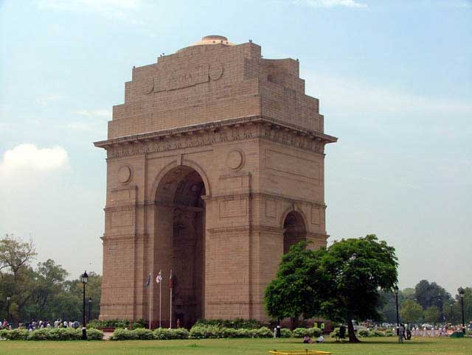
India Gate
(originally All-India War Memorial)

Slide 2
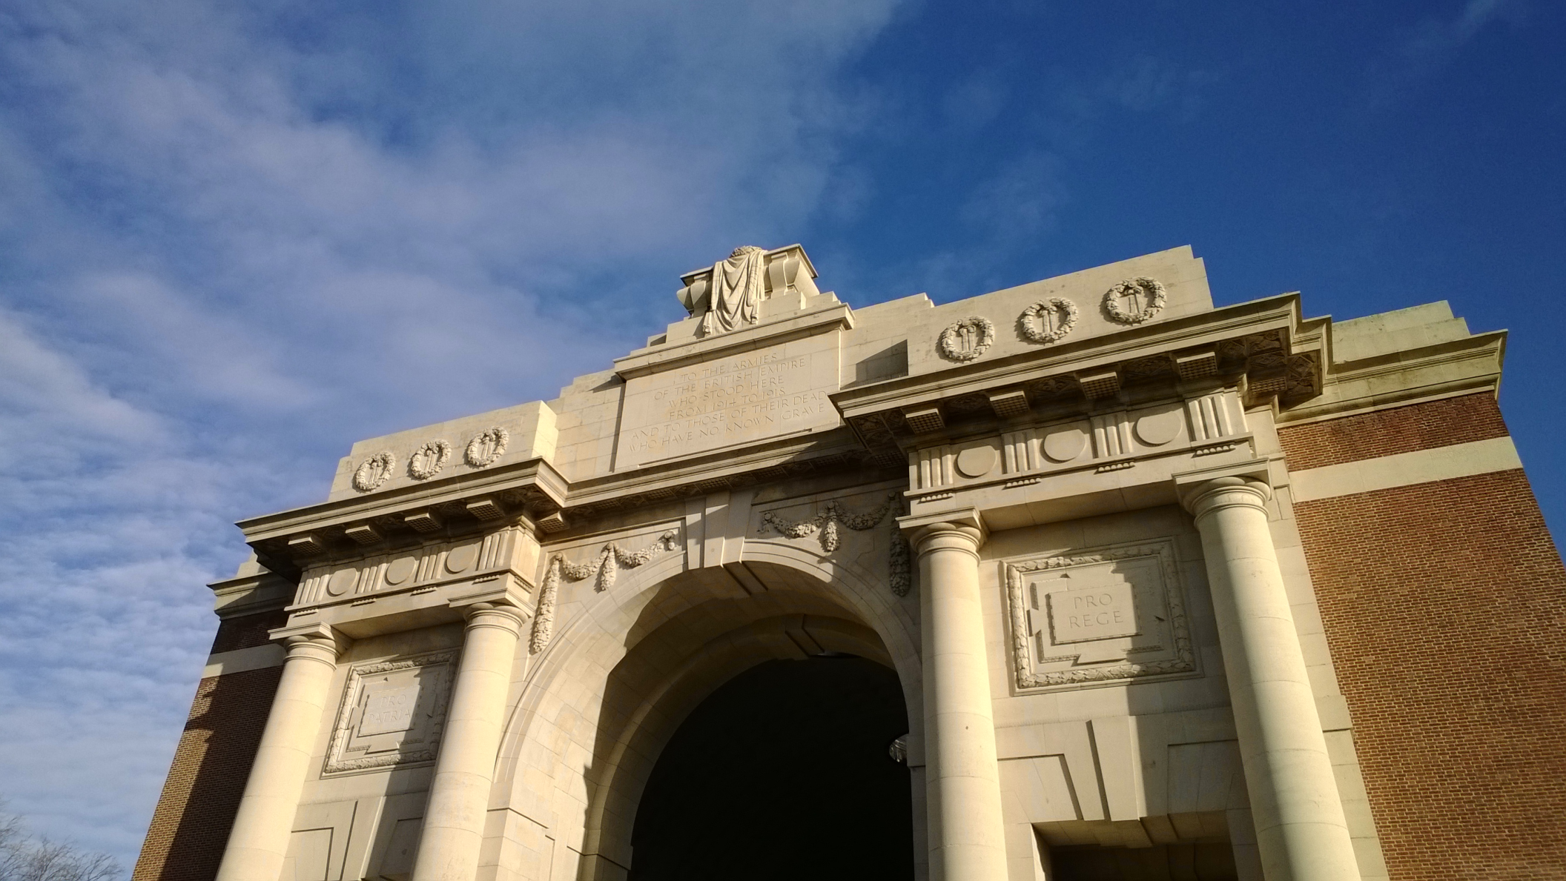
Menin Gate, Ieper (Ypres)

Slide 3
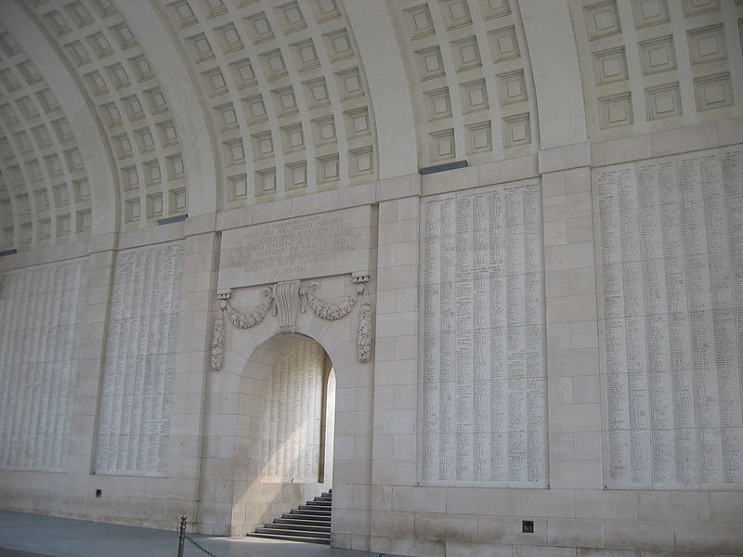

Slide 4
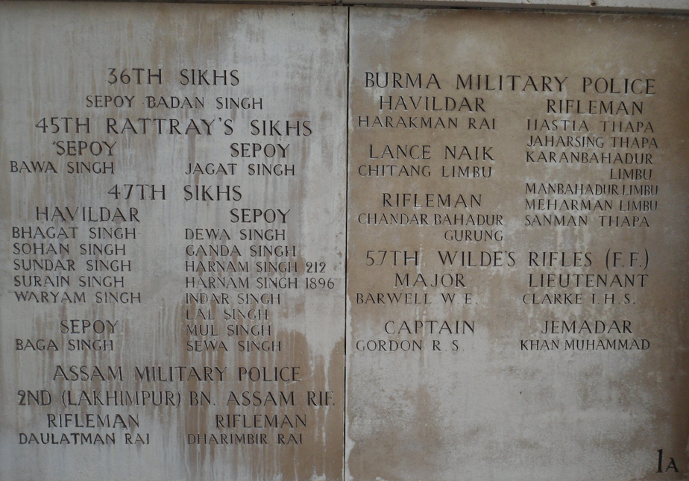

Slide 5
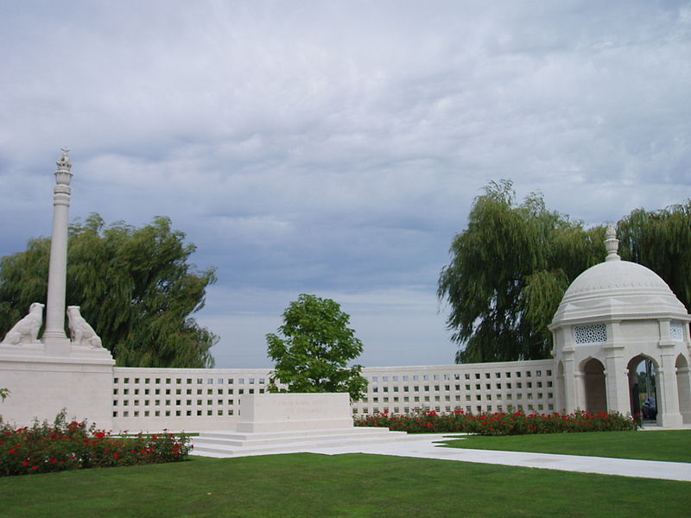
Neuve Chapelle Memorial

Slide 6
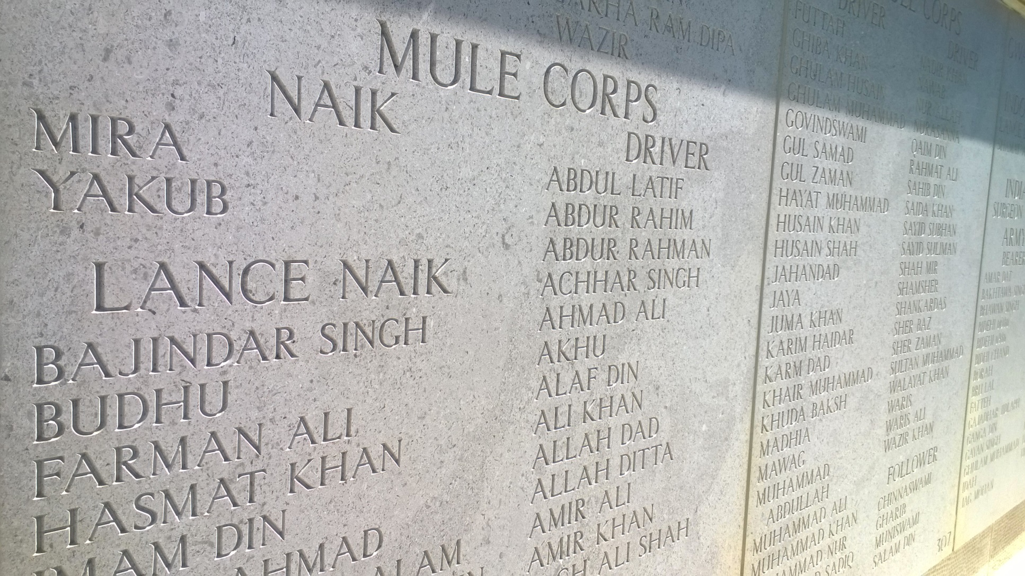
Helles Memorial – Mule Corps

Slide 7
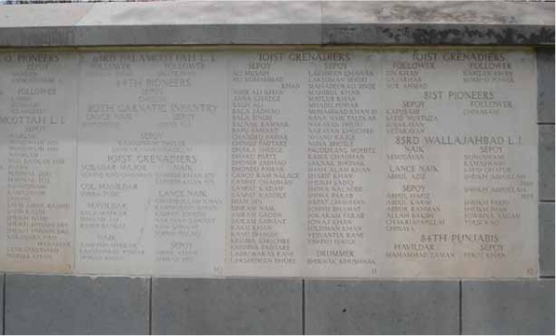
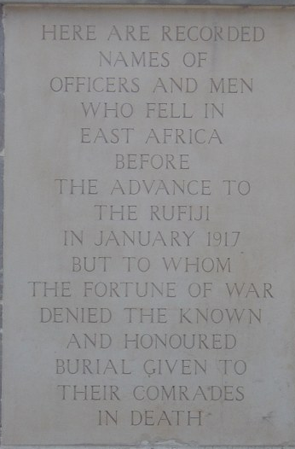
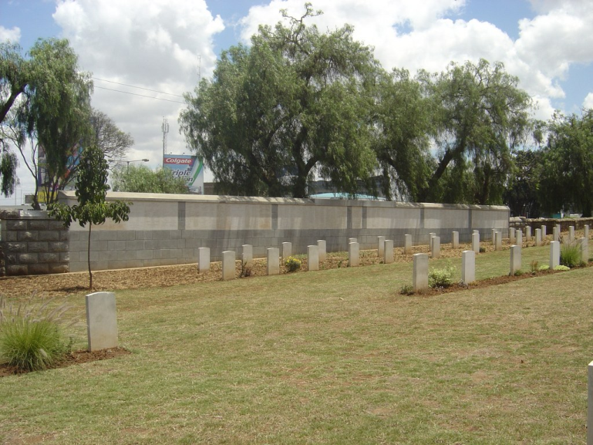
Nairobi British and Indian Memorial

Slide 8
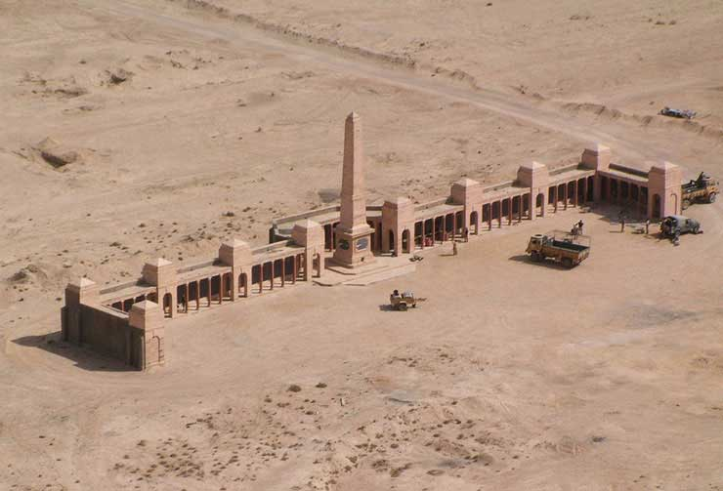
Basra Memorial

Slide 9
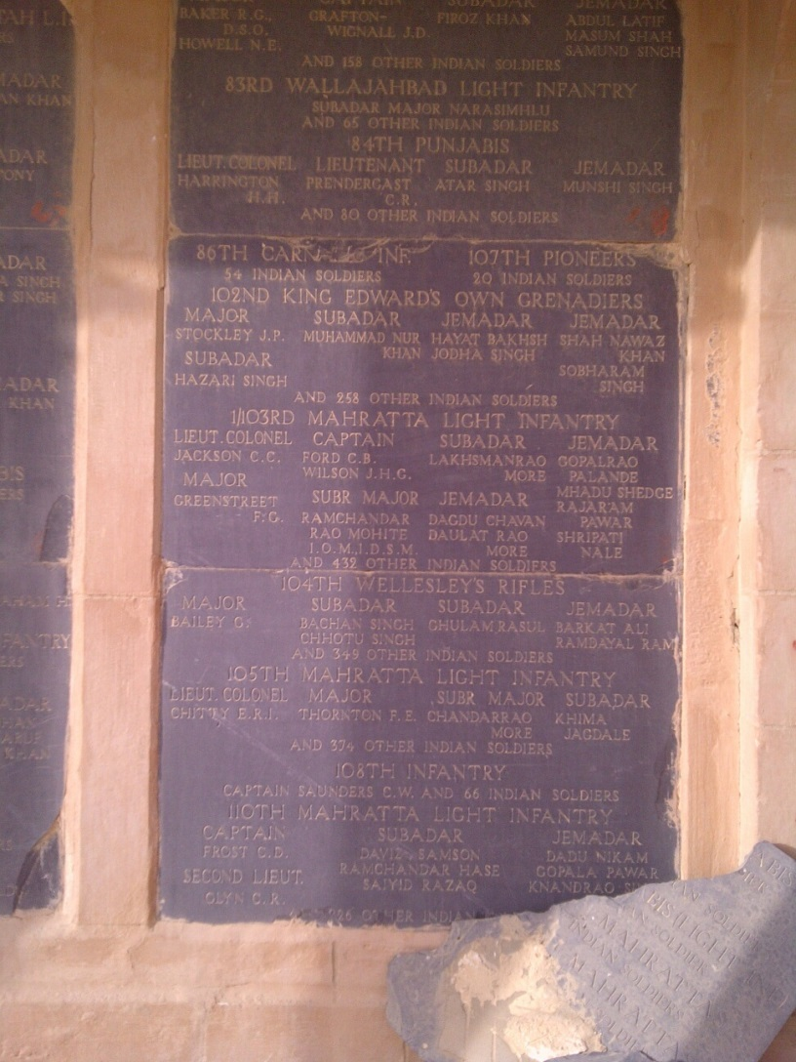
Basra – Names and Numbers

Slide 10
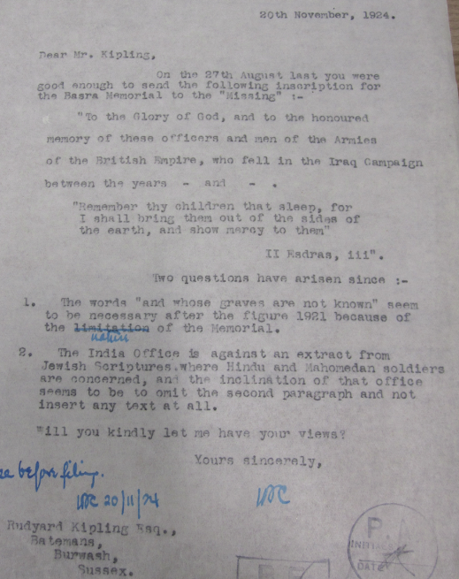
Basra Inscription

Slide 11
Indian Forces of the
First World War
Number Commemorated
by CWGC by Modern Country

Slide 12
Indian Forces of the First World War commemorated by CWGC
Selected Unit Designations

